Slide 1





Dr. Manju Khurana
Assistant Professor, CSED
TIET, Patiala
manju.khurana@thapar.edu

Slide 2








Intel’s Programmable Counter/ Timer Device (8253/8254) Facilitates
Not Possible To Generate Accurate Time Delays Using Delay Routines in 8086
Accurate Time Delays
Minimizes Load On Mp
Real Time Clock
Event Counter
Digital One Shot
Square Wave Generator
Complex Waveform Generator

Slide 3


8253
8254-ADVANCED VERSION OF 8253
8254 can operate with higher clock Frequency Range ( up to 8 Mhz AND 10 Mhz FOR 8254-2)
8253 can operate at frequency up to 2mhz

Slide 4

Features of 8253
High speed and low power consumption is achieved through silicon gate CMOS technology.
Completely static operation.
Three independent 16-bit down counters.
Operates on 3V to 6V single power supply.
Six counter modes available for each of the three counters.
Binary and decimal counting is possible.
For 8253 DC to 2.6 MHz operating frequency range and for 8254 DC to 8 MHz operating frequency range.
24-pin dual in line package.
8253 PIT is a programmable interval timer/counter specifically designed for use with the Intel microcomputer system.

Slide 5

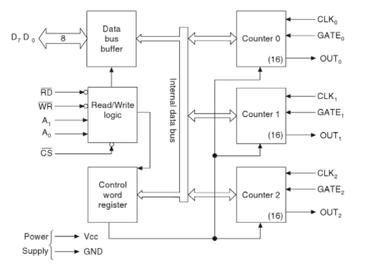
Functional Block Diagram of 8253 PIT

Slide 6
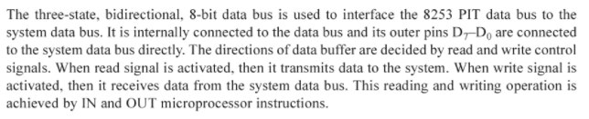

1. Data Bus Buffer

Slide 7
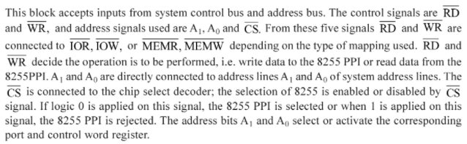
2. Read/Write Logic

Slide 8

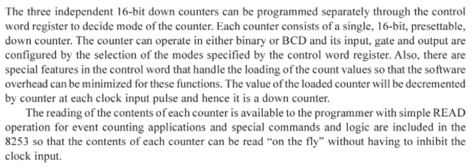
3. Control Word Register
4. Counters 0, 1 and 2

Slide 9
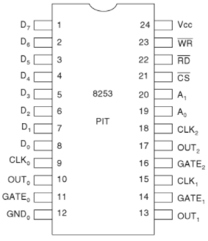
Pin configuration of 8253 PIT

Slide 10

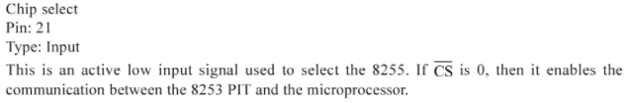
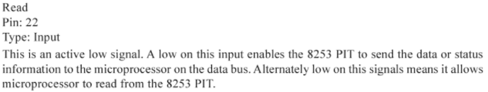
1. D₇ – D₀
2. CS
3. RD

Slide 11


4. WR

Slide 12
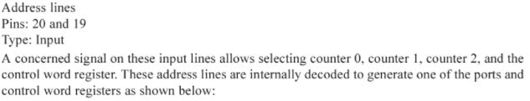
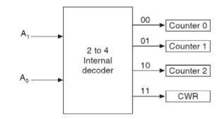
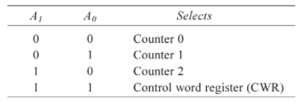
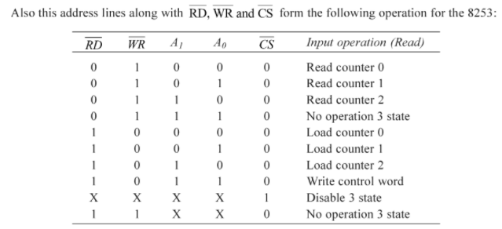
5. A₁ and A₀

Slide 13
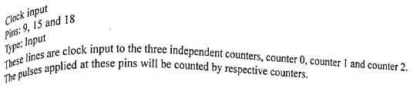
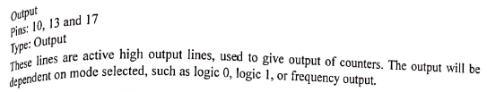
6. CLK₀, CLK₁ and CLK₂
7. OUT₀, OUT₁ and OUT₂

Slide 14
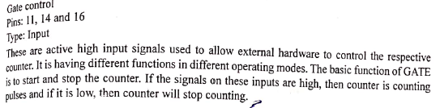
8. GATE₀, GATE₁ and GATE₂

Slide 15


